Slide 1
INTRODUCING
PARTIALLY ADDRESSED
ADVERTISING MAIL
WHAT IS PARTIALLY ADDRESSED ADVERTISING MAIL AND HOW WILL IT WORK
October 2018

Slide 2
WHAT WE’D LIKE TO COVER TODAY
1. What is partially addressed?
2. How will the targeting work?
3. What are the key metrics?
4. What are the practicalities?

Slide 3
WHAT IS PARTIALLY ADDRESSED?

Slide 4
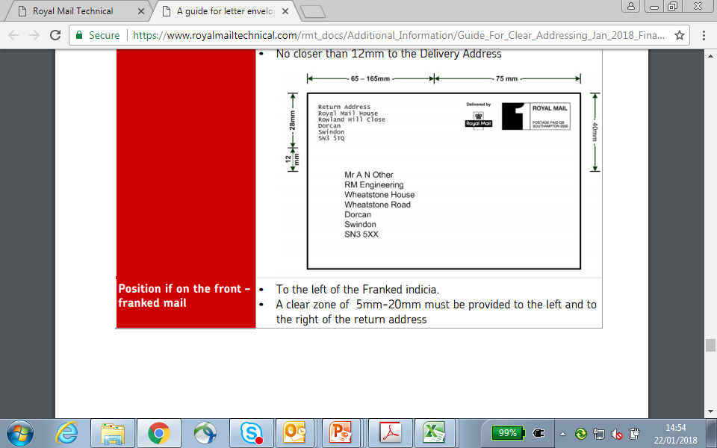
WHAT IS PARTIALLY ADDRESSED?
Partially Addressed Mail is a standard addressed advertising mail product that identifies customers using sophisticated targeting options without the use of personalised data.
Partially Addressed enables acquisition without the use of personal data, by targeting households using geo-demographics at postcode level (c.15 households).
Existing customers are removed, so you are not wasting your budget or sending them acquisition material when they are already one of your customers.
It contains no personal information about the recipient. The mailings will be partially addressed to the ‘occupant’ or to ‘holiday lover’, whatever you want to choose.
Collective Name
Campaign specific stand-in for name
Notes:
Partially Addressed Mail is a standard addressed advertising mail product that identifies customers using sophisticated targeting options without the use of personalised data.
It target households using geo-demographics at postcode level which covers 15 households on average.
Your existing customers are removed so you are being cost efficient and this ensures your current customers aren’t receiving acquisition marketing from you.
Importantly it contains no personal information about the recipient and it is addressed to a collective campaign name such as ‘the occupant’.

Slide 5



CONSUMER TARGETING
Here’s what the DMA says about door drop targeting
methods.
Door drop targeting identifies groups of households rather than individuals and therefore doesn’t contain personal data about the recipient.
You are allowed to target postcodes using household profiles and you can analyse existing customers in order to target similar types of people.
Partially Addressed mail uses similar targeting methods as door drop as it only uses geo-demographic profiling and the use of an existing customer base to target look-a-likes.
Notes:
The DMA have stated that door drop targeting is identifying groups of households rather than individual so it isn’t using personal data about the recipient. Partially addressed uses similar targeting methods to door drops as it is only using geo-demographic profiling of houses and look-a-like areas of your current database.

Slide 6
HOW DOES THE TARGETING WORK?

Slide 7


PARTIALLY ADDRESSED IS roughly 165 TIMES
MORE Targeted Than door drop
Partially addressed is targeted at postcode level (c.15 households) and uses your existing
customer postcodes to target other houses in customer ‘rich’ postcodes or targeting
software to identify similar customer postcodes using geo-demographic profiling.
TOPPING UP
LOOK-A-LIKES
Combining both methods will give you great coverage of potential customers, helping to make your campaign successful
+
Top up postcodes already rich in existing customers
Use geodemographic profiling to find look-a-like prospects
Notes:
Partially addressed is targeted at groups of approximately 15 households at a time. It uses your existing data to target similar households in ‘rich’ postcodes or identifies similar postcodes using geo-demographic profiling. Combining both of these methods will give you greater coverage of potential customers, making a success of your campaign.

Slide 8
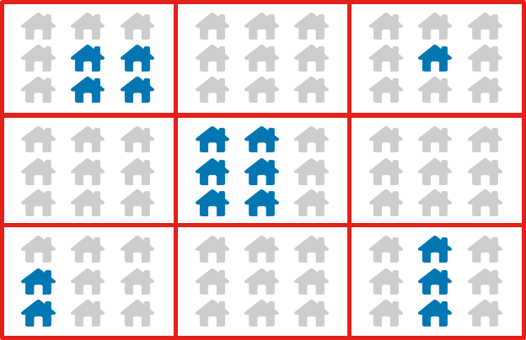
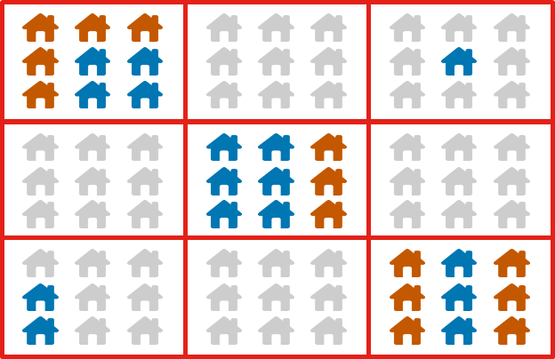
Topping up
In these 9 postcodes the existing customers appear in blue, we can then top up in the postcodes where there’s a high proportion of existing customers based on the assumption the remainder of the postcode will contain good prospects.
9 POSTCODES
Where there are existing customers
Three postcode areas are topped up
This allows you great penetration in areas where your product and/or service is already being used
Notes:
Topping up uses your existing database and identifies where you have multiple customers in a certain postcode. The houses in these postcodes that aren’t on your database will then be targeted and will receive your marketing material. This allows you to fully utilise areas where your product/service is already being used.

Slide 9
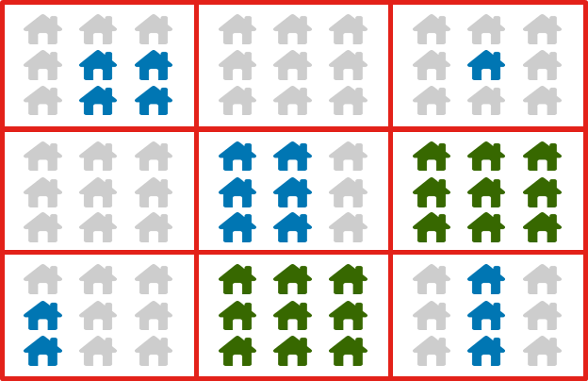
Look-a-likes
Use geodemographic targeting tools like MOSAIC or CAMEO to identify postcodes with similar characteristics to existing customers.
9 POSTCODES
Where there are existing customers
Similar postcodes are targeted
This helps you find customers in new areas who are likely to be interested in buying your product and/or service
Notes:
The use of geo-demographic software tools like MOSAIC or CAMEO can help identify postcodes that have similar characteristics to your existing customers. Those households will then be targeted and gives you the opportunity to acquire new customers who are likely to be interested in your product or service.

Slide 10
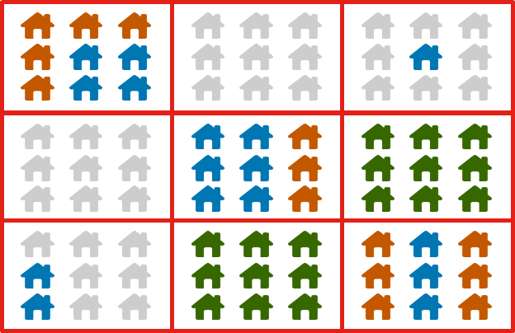
COMBINATION OF TOPPING UP AND
LOOK-A-LIKES
Combine both of these methods for maximal effect for your campaign.
9 POSTCODES
Where there are existing customers
New prospects using both methods
Combine both methods to create a highly targeted way to find new customers using non-personalised data
Notes:
You can run both of these targeting methods at the same time to give yourself vast coverage. This creates a highly targeted way for you to find new customers using non-personalized data.

Slide 11
WHAT ARE THE KEY METRICS?

Slide 12
IT COSTS LESS THAN COLD PROSPECTING
BUT A LITTLE MORE THAN DOOR DROP
Limited availability post-GDPR
 | Cold Acquisition | Partially Addressed | Door Drop
Data Cost | 10p | 0p | 0p
Postage | 21p | 17p | 5p
Print and production | 20p | 20p | 8p
TOTAL cost per item | 51p | 37p | 13p
Delivery points reached with £50k budget | 98,039 | 135,135 | 384,615
Volume multiplier |  | x1.38 | x3.92
Targeting flexibility | High | Medium | Low
*For illustrative purposes only
Partially Addressed is cheaper than cold acquisition.
With a saving on the postage there’s a total saving of 14p per item.
Budget to reach 38% more households than before.
Notes:
Partially addressed is a cheaper alternative to cold acquisition. As each item will cost 14p less to send because there are no data costs and the postage is lower, you will be able to target 38% more households than before for the same cost as one of your previous campaigns.

Slide 13
WHAT MIGHT RESPONSE RATES
LOOK LIKE?
 | Cold Acquisition | Partially Addressed
Test volume | 1,000,000 | 1,307,692
Required response rate | 0.50% | 0.36%
Number of responders | 5,000 | 5,000
Postage | £0.21 | £0.17
Data costs | £0.10 | £0.00
Print and production | £0.20 | £0.20
Cost per item | £0.51 | £0.37
Total cost | £510,000 | £510,000
Average contribution per responder | £150 | £150
Total expected contributions | £750,000 | £750,000
Profit | £240,000 | £240,000
ROI | £1.47 | £1.47
*For illustrative purposes only
0.36% response rate required to achieve ROI parity
Notes:
If you ran a cold campaign of 1 million items which achieved a response rate of 0.5% and profits of £240,000, to achieve ROI parity doing a partially addressed campaign, your required response rate would only need to be 0.36%.

Slide 14
86% OF PARTIALLY ADDRESSED MAIL IS
ENGAGED WITH
n = 19,646
n = 817
n = 9,551
ENGAGED: % of mail processed in some way including – opening, reading, sorting, put aside for later, filed, put on display, put in the usual place.
MINIMALLY PROCESSED: % of mail recycled only
Base: All advertising mail; JICMAIL Q2 2017 – Q1 2018
Notes:
86% of partially addressed items were engaged with compared to 94% of addressed advertising mail and 72% for door drops. This suggests people view partially addressed items more like addressed mail than door drop because of the rates it is being processed.

Slide 15
WHAT ARE THE PRACTICALITIES?

Slide 16
SIMPLE PROCESS – 5 STEPS
Review response against A/B test
Full targeting data to execute selections
MEASURE
BROADCAST
Analysis and findings shared with recommendations for approval
05
Client to provide existing postcode data for profiling
CREATE
04
SUPPLY DATA
03
Agree targeting options and campaign volumes
KICK OFF
02
If you have geo-demographic software like CAMEO or MOSAIC we can advise about creating the Partially Addressed PAF file so that you can do this yourself or working with a third party supplier.
01
Notes:
The process to run a partially addressed campaign is simple. Royal Mail can support you through this process and the steps are as follows:
1. Agree the targeting options and the size of campaign you want to run
2. You need to provide existing postcode data so that they can be profiled
3. The data will be analysed and the findings will be shared
4. Once the targets have been agreed, you can send your marketing communications to those addresses
5. Monitor the performance of the campaign
If you have geo-demographic software like CAMEO or MOSAIC or one of your partners/suppliers does, we can provide you with the Partially Addressed PAF file so that you can do this without our help.

Slide 17
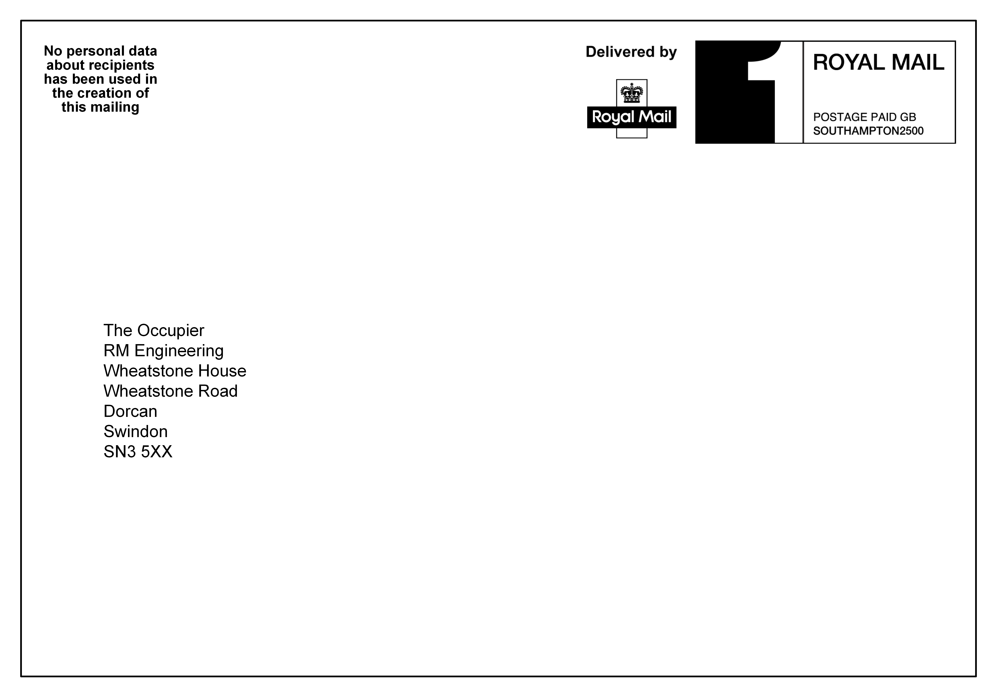
INCLUDE A DECLARATION
ON YOUR MAILING
All Partially Addressed Mail has to carry a “declaration” message to assure the recipient that no personally identifiable details have been used in the creation of the mailing. This may be on the inside or outside of the mail pack but it must be outside of the required clear zones in the footnote area.
To ensure your mailing is compliant you must send us a sample of your mailing either by PDF (preferred) or in physical form to ensure the requirements are met and to ease any concerns you may have. You will not be eligible for the discount if this isn’t provided.
No personal data about recipients has been used in the creation of this mailing
Campaign specific stand-in for name
Collective Name
Notes:
You need to put a declaration on your mailing to assure the recipient that no personally identifiable details have been used to target them. This may be on the inside or outside of the mail pack but it must be outside of the required clear zones in the footnote area.
We request that you send us a copy of your mailing, preferably by PDF, so that we can ensure it is complaint. If we do not receive your mailing then unfortunately it will not be eligible for the partially addressed discount.

Slide 18
SUMMARY BENEFITS
USES NO PERSONAL DATA
ABOUT THE RECIPIENT
COMBINED TOP UP AND LOOK-A-LIKES TARGETING
TARGETED TO c15 HOUSEHOLDS
ADDRESSABLE – “HOLIDAY LOVER”
CHEAPER THAN COLD
MAILING
INCREASE YOUR BRAND AWARENESS
Notes:
To summarise, partially addressed is a highly targeted method to acquire new customers. It targets to roughly 15 households at a time and uses no personal data about the recipient.
You can combine both methods to achieve larger coverage of potential customers. This will increase your brand awareness as you can target more customers than before due to it being cheaper than traditional cold acquisition.

Slide 19
APPENDIX
MORE DETAILED TARGETING DESCRIPTION AND FURTHER COMPLIANCE INFORMATION ON ENVELOPE

Slide 20
PERMITTED SERVICES
Partially Addressed Mail, including postcards which meet the 2/3 ply specifications, must be posted using Mailmark.
For postcards which do not meet the 2/3 ply specification, items should be posted using 1400/High Sort.

Slide 21
PRIVACY AND SUPPRESSIONS
Advertisers are advised to maintain a documented internal procedure for suppressing customer and prospect data for people that have opted out of receiving Partially Addressed Mail.
This must be in place and mailing files checked thirty days or less before Partially Addressed Mail items are posted to ensure those who have opted out are not targeted.
Royal Mail recommends that advertisers place a time limit on these suppressions to a minimum of 2 years to account for people who move home. It needs to be made clear to the end customer that this procedure is in place.
Advertisers could also use the Mailing Preference Service file up-front to supress at a household level to ensure that they don’t target people who have opted out at a wider level rather than directly with the company. Royal Mail recommends this approach is used but it is not mandatory.
Notes:
We recommend that a document is maintained for supressing customer and prospect data for people who opt out of receiving partially addressed mail.
This must be in place and mailing files checked 30 days before a partially addressed campaign is mailed to ensure those who have opted out aren’t targeted.
We suggest putting a time limit of 2 years on suppressions to account for people who move house and this needs to be made clear in your opt out procedure.
You could combine with the mailing preference service file up-front to avoid targeting those who have opted out on a wider level rather than directly with you, but this is only recommended, not mandatory.

Slide 22
USE OF PAF WITH PARTIALLY ADDRESSED
    Customers must use a version of PAF that removes any postcode that contains only a single household and any household that contains personal data, for example Roberts’ Residence

Slide 23
HOW TO ENSURE COMPLIANCE
IN MORE DETAIL
All Partially Addressed Mail has to carry a “declaration” message to assure the recipient that no personally identifiable details have been used in the creation of the mailing.
The declaration may be placed either:
in any location on the first page of the inner mailpiece (where applicable);
in any location on the back face of the item; or
on the front face of the item.
If the address is to be placed on the front face of the item, the Declaration must also:
not be positioned in clear zones;
be printed using black Arial 10pt bold font with normal line spacing and be centre justified;
where a Return Address is also included on the front of the item, be placed in the location shown in Figure 1 overleaf, or, where a Return Address is not included on the front of the Mailing Item, be placed in the location shown in Figure 2 overleaf; or
In the case of postcards, as an alternative to (b) or (c) above, the declaration may be printed linear format, in any readable font, on the vertical left edge of the item. Figure 3 overleaf illustrates the two alternatives for the position of the declaration for postcards.
Royal Mail must receive the sample no later than 10 working days following the posting date to ensure conformance to the Partially Addressed Mail product specification has been met.
23

Slide 24
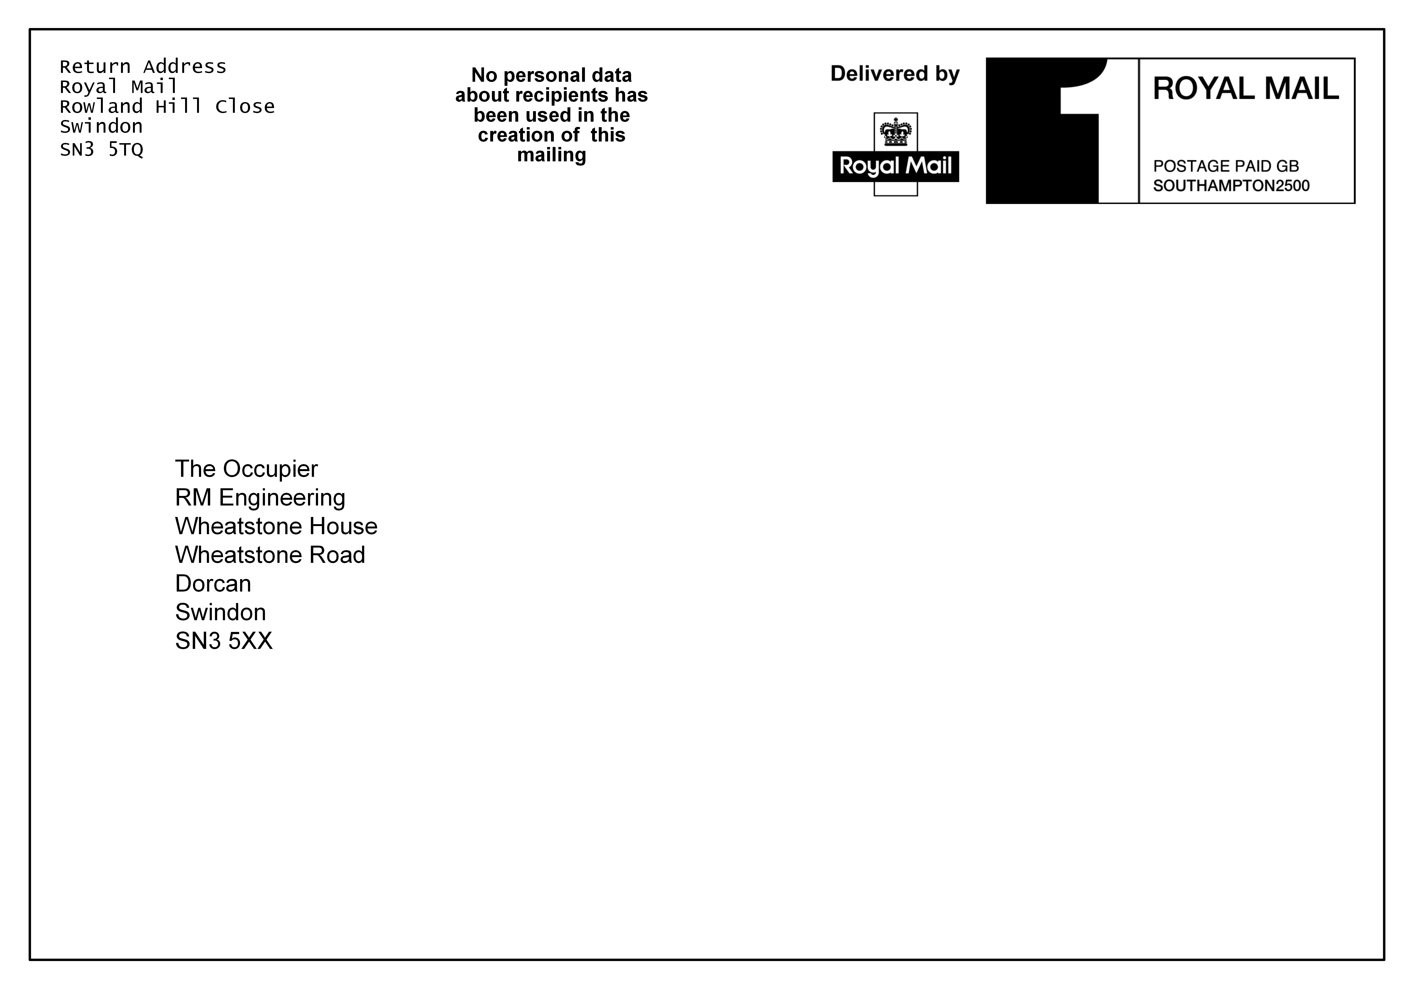
DECLARATION EXAMPLES
Fig 1: Mailing Item bearing Declaration and return address on the front
24

Slide 25
DECLARATION EXAMPLES
Fig 2: Mailing Item bearing Declaration but no return address on the front
25

Slide 26
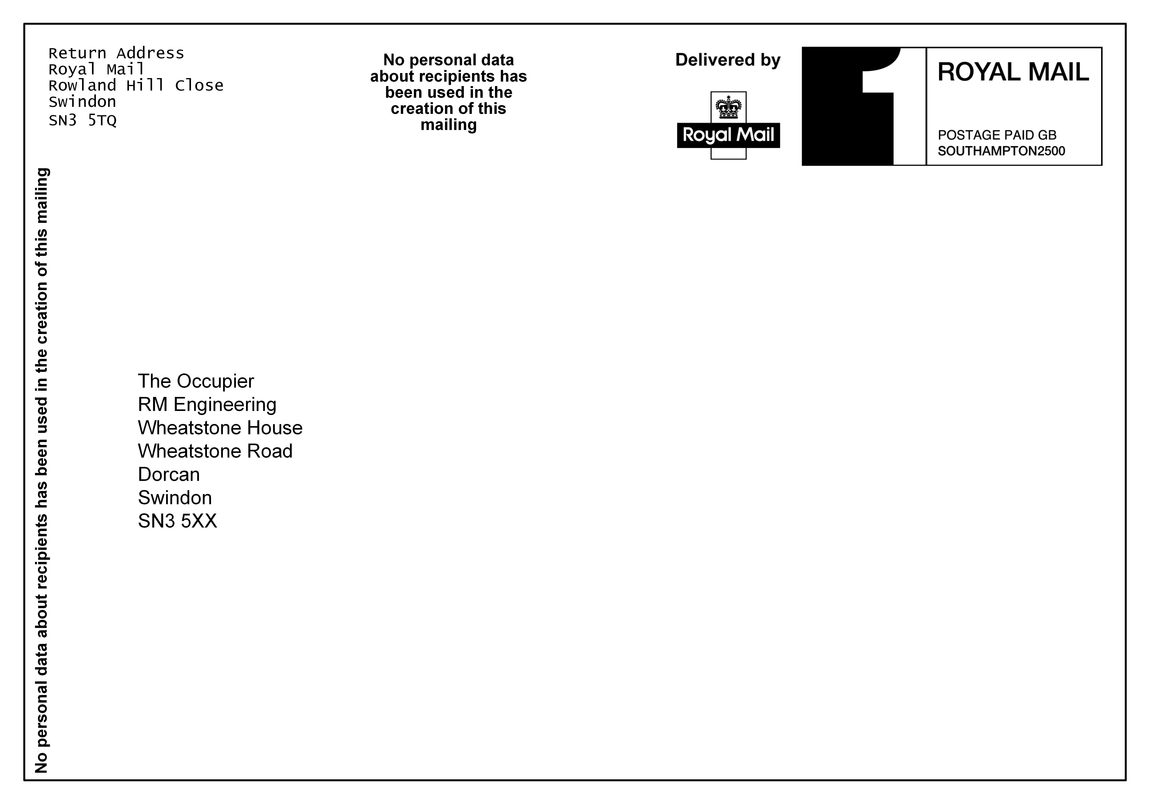
DECLARATION EXAMPLES
Fig 3: For postcards only, the Declaration location can be placed in either of the positions shown
26

