Slide 1
Mailmark Reporting Migration Training
Mailmark Direct Data
November 2020

Slide 2

All Parties/Members agree that this meeting will comply with Competition Law at all times. At no time will the parties exchange or discuss any commercially sensitive information, including but not limited to, customers, prices, volumes, costs, planned investments, confidential operational processes, etc

Slide 3


Today’s content
1
Introduction and housekeeping
6
Testing options
2
Background to Mailmark Direct Data
7
Where to find help
3
What is Mailmark Direct Data?
8
PDF summary
4
Technical overview – Access, Security, Data Extraction
9
Time for questions
5
Onboarding process
10
End

Slide 4
Background To Reporting Migration
3 key reasons for the change
Royal Mail IT refresh
Data opportunities
Successful customer testing

Slide 5
What’s changing?
Current
New
Customers access data through an online eBusiness (www.royalmail.com) portal, using Adobe Flash
There will be two levels of Mailmark reporting functionality
Summary Reports can be saved in PDF
Item level exception reports can be saved in PDF or CSV
PDF Reporting: accessed daily via the current eBusiness portal
Mailmark Direct Data: accessed daily via a data transfer system (Secure File Transfer Protocol based technology)

Slide 6
What is Mailmark Direct Data
Direct Data is the detail of your Mailmark postings, presented in a raw data format.
The data is in a CSV format and will be presented in two separate reports, which may have more than one file, depending on the volume of records that have been processed
This data can be accessed using credentials provided by Royal Mail.
The data files are compressed to reduce issues in transmission.

Slide 7
What is Mailmark Direct Data
The two reports that you will receive upon request are:
1. Summary report
2. Item level report
The eManifest summary report shows a daily snapshot of current postings during the active 5 day window that an eManifest is open. The report shows a summarised view of the posting volumes vs the eManifest, similar to the current Mailmark reports.
The report will show active data (data that is updated every day in an open eManifest). You would use this report to delve into the detail of a query e.g. investigate potential adjustments. By building up data over time you would be able to establish if patterns occurred.

Slide 8
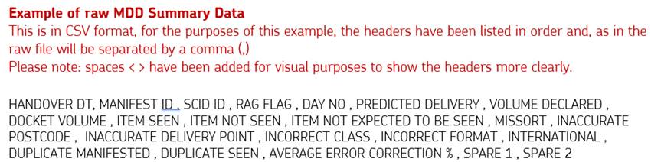
Sample data structure 1
Example of raw MDD Summary Data

Slide 9
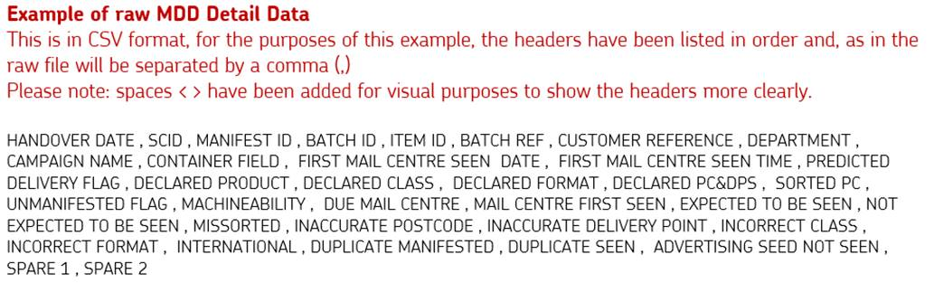
Sample data structure 2
Example of raw MDD Detail Data

Slide 10

Technical overview

Slide 11
Access and Security
Request Access to your data from Royal Mail
You will be provided with a unique password linked to your user request and Participant ID(s).
You need to set up a Secure File Transfer Protocol key (SFTP).
  SFTP is a file protocol for transferring large files over the web. The data that is transferred is protected by encryption.
  There are a number of opensource tools which can be used to retrieve the Mailmark Direct Data files from the SFTP server.
Please note: Royal Mail does not recommend one tool over the other and it is your responsibility to ensure the chosen programme meets your company’s security policies.
An optional software solution to create an SFTP Private/Public Key: PuttyGen
Download the following link PuttyGen documentation

Slide 12
File information
File naming convention is as follows:
  Summary-(Customer_id)-(DATE)-(Time).csv
  Detail-(Customer_id)-(DATE)-(Time)-(nnn).csv.gz
Consideration of the file size (up to 1 million rows of data)
  Summary: 5MB
  Detail: 4GB
Additional security access option through the use of a SSH Public Key
Report data timings
  These provide data for live mailings with a handover date within the last 5 days and are available up to 7 days
  Available each day Monday to Saturday (excluding Sundays)
  Time of the data to be confirmed following testing

Slide 13
Data extraction
Customers can choose a preferred application for extracting data from compressed files.
To support those unfamiliar with dealing with large data files there is some guidance to use 7-ZIP. This can be found in our Technical Specification for Mailmark Direct Data (downloading data).
https://www.7-zip.org/
Royal Mail Wholesale - Mailmark reporting updates
Royal Mail Retail (Technical) - Mailmark reporting updates

Slide 14
Where does direct data come from?
The data you will receive will come from three information sources:
1. eManifest
2. Barcode
3. Derived
Details a participant has uploaded to one of their Supply Chains
Details included in the barcode string and should be reflected in the eManifest
Data outputs during processing e.g. an item is mis-sorted as was due in Newcastle Upon Tyne but was first seen in Aberdeen
The purpose of this detail is to enable you to develop your software/integration solution to separate the variable length file data files (CSV) with associated header records. Giving a name to each field at specific points to enable the data to be used in a meaningful way.

Slide 15
Data dictionary
DATA FIELD | DESCRIPTION | DATA SOURCE
Handover Dt | The date the mail was due to be handed over to Royal Mail. | eManifest
Manifest ID | Unique number linked to a posting. | eManifest
RED FLAG | Status of posting. GREEN successful mailing, AMBER, some minor errors, RED multiple or significant issues. | Derived
Day No | Number of days after the handover date. | Derived
Predicted Delivery | Royal Mail’s prediction of what will be delivered and when. This column is an additional requirement in the current scope which is displayed currently as null but in future when it will be pulled from the database it will be displayed as ‘YYYY-MM-DD’ | Derived
Missort | Number of items processed at the wrong Mail Centre that have been re-routed to the correct Mail Centre for delivery. | Derived
Inaccurate Postcode | Number of items where the Postcode declared within the eManifest or barcode is inaccurate (versus PAF) or missing or 9z used. | Derived
Inaccurate Delivery Point | Number of items where the Delivery Point Suffix (DP). | Derived
Incorrect Class | Number of items that do not match the class declared within the eManifest | Derived
Duplicate Manifested | Number of items where the item ID is duplicated in the eManifest. | eManifest
Duplicate Seen | Number of items with multiple track events on Royal Mail’s sorting machines where tracking information identifies more than one physical item with the same unique ID. | Barcode

Slide 16
Mail Centre mapping
To save on file storing and transmitting space Royal Mail has provided a mail centre mapping table for you to build into your systems.
Mail Centres will be identified with a number instead of a name. For example:
You will find the full mapping table in the Direct Data Technical Specification Access and Onboarding document

Slide 17
Onboarding process 1
To have access to Mailmark direct data you must be a Participant in a Supply Chain and will need to email your Account Manager or Mailmark@royalmail.com:
1. Contract
2. Agreement
3. Proforma
Royal Mail will then issue a Direct data contract
You will need to read through and agree the contract
Royal Mail will then send you a proforma that you will need to fill in and send back.

Slide 18





Onboarding process 2
The following information is requested in the direct data proforma
A.
To include Main ID and additional company Participant ID’s to be linked to the ‘parent ID’
B.
Company /
Business Name
C.
Contact details, including: name, email address, contact number, job title
D.
Confirmation that the email address provided has been registered on www.royalmail.com as a business user
E.
In the event of a customer wishing a password free connection, the SSH Public key must be provided

Slide 19



Onboarding process 3
During the initial onboarding, access will be provided within 48 hours to customers who have signed the MDD contract
A.
A unique username in numeric form
B.
A unique password which is formatted as 9 characters long with letters (capital and small caps), numbers and symbols, randomly sequenced
C.
A unique directory structure where the compressed files will be available

Slide 20
Testing Process
To allow you to test your systems and processes we have created an example file that is available via a test folder. You do not need to be a Participant in a Supply Chain to access the dummy data but you do need to be given access.
You will require an access ID, a password and a URL.
To be set up for a test account email Mailmark@royalmail.com requesting access. You will then need to fill in the Royal Mail Proforma for us to set you up with your unique details.
Once set up we will send you a Dummy file over the SFTP for you to test your systems

Slide 21
Mailmark Direct Data – where to find help?
Read the technical user guide for the MDD solution at:
Royal Mail Wholesale - Mailmark reporting updates
Royal Mail Retail (Technical) - Mailmark reporting updates
email any queries that you have to your account manager or contact the Mailmark team at Mailmark@royalmail.com

Slide 22
PDF Reporting
What is it?
A series of PDFs presented through the Royal Mail eBusiness portal in the same way as current Mailmark Reporting. These PDF’s provide summary information on:
  Predicted delivery
  Volumes
  Mailing performance
This reporting is ideal for customers with light to medium use of Mailmark information who are interested in:
  The performance of their important mailings
  Want to monitor their mailings but do not require item level detail
What are the benefits?
Simple to use Mailmark Reporting refreshed daily
Reports use familiar Mailmark metrics and presentational style
Accessed via Royal Mail’s eBusiness portal in the same way as Mailmark Reporting is currently accessed
Limited if any staff training required if current Mailmark Reporting is used

Slide 23
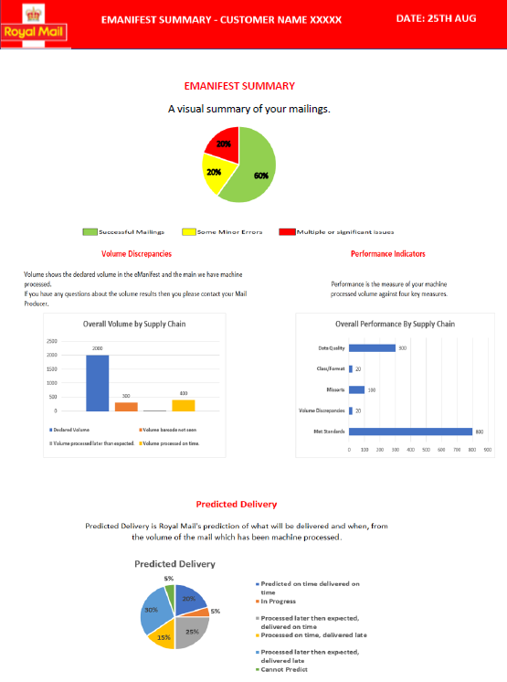
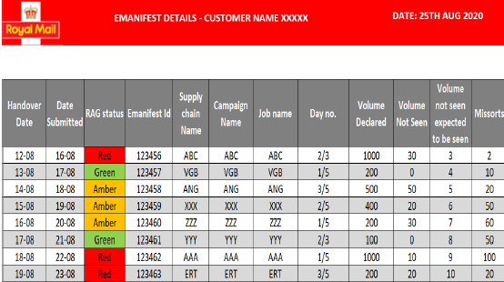
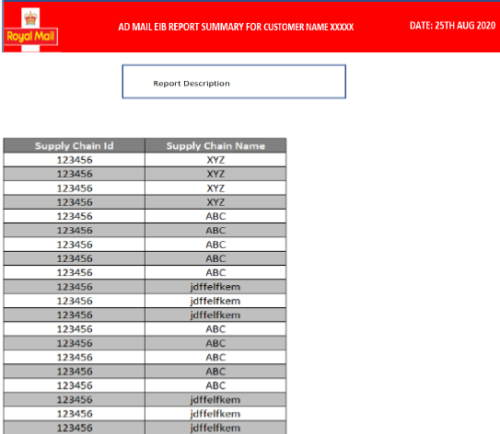
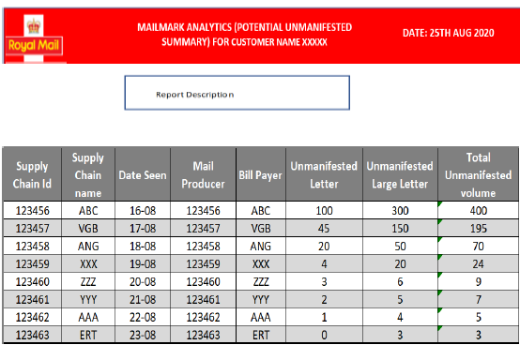
Simple PDF Reporting – Example daily report
Summary level report
High-level performance report
Gives a quick overview of how all your eManifests are performing
Shows a breakdown of eManifests and how they are performing
Provides a summary of how many items have been seen, not seen and not expected to be seen
Details the performance of your mailings (Data quality, class/format, missorts, volume discrepancies, met standards)
Unmanifested report
Predicts when your mailings are going to be delivered
Shows the Supply Chains that have items which are unmanifested

Slide 24

Questions?

Slide 25
Thank you

