Slide 1
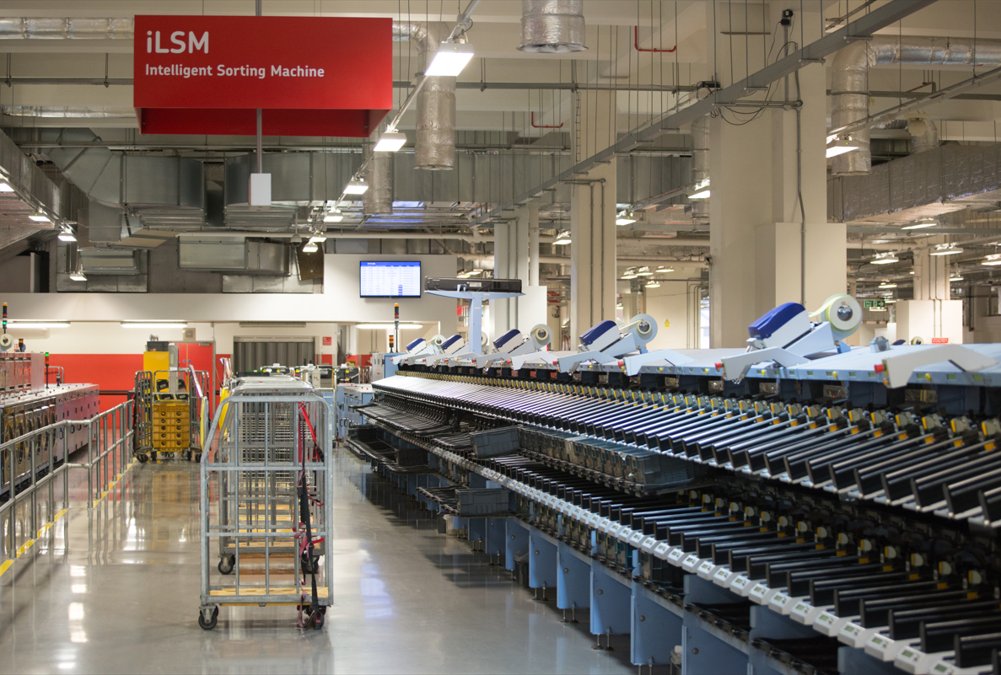
MAILMARK
PDF REPORT CHANGES
4th April 2024
Version control. 1.3 to v2.0, Issue date: 20 April 2021 to 4th April 2024

Slide 2
Reports Affected
Daily Report
Historic Report
Summary of additions
Addition | Active | Active | Historic | Historic
 | Manifested | Potential UnManifested | Manifested | UnManifested
Total Volume Seen | ☑ | ☒ | ☑ | ☒
Volume Seen on Wrong Machine | ☑ | ☑ | ☑ | ☑
% Mail seen on Wrong Machine | ☑ | ☑ | ☑ | ☑
AEC % | ☑ | ☒ | ☑ | ☒
Notes:
17

Slide 3
ACTIVE REPORTS
Active Summary Report, eManifest Details
Addition of the following four metrics; Total Volume Seen, Volume Seen on wrong machine, % Mail seen on Wrong Machine and AEC%
Adjustment of the column order to make it more logical so the data is grouped by;
Posting information (Handover date, Date submitted, RAG Status, eManifest ID, Supply Chain ID, Supply Chain Name, Day No)
Volumes (Volume Declared, Total Volume Seen, Volume Not Seen Not expected to be seen, Volume not Seen, Volume Seen on Wrong Machine, % of Mail seen on wrong machine)
Performance (Machineability, Missorts, AEC%)

Slide 4
Active eManifest
3. Active Summary Report, Potential unManifested Details
Addition of the following two metrics; Volume Seen on Wrong machine, % Mail seen on Wrong Machine.
Adjustment of the column order to make it more logical so the data is grouped by;
Posting information (Supply Chain ID, Supply Chain Name, Date Seen, Mail Producer, Bill Payer)
UnManifested volumes (UnManifested Letter, UnManifested Large Letter)
Volumes (Total Volume Seen, Volume Seen on Wrong Machine, % of Mail seen on Wrong Machine)
Notes:
17

Slide 5
HISTORIC REPORT
Historic Summary Report, eManifest Details
Addition of the following four metrics; Total Volume Seen, Volume Seen on wrong machine, % Mail seen on Wrong Machine and AEC%
Adjustment of the column order to make it more logical so the data is grouped by;
Posting information (Handover date, Date submitted, RAG status, eManifest ID, Supply Chain ID, Supply Chain Name)
Volumes (Volume Declared, Total Volume Seen, Volume Not Seen Not expected to be seen, Volume Not Seen, Volume Seen on Wrong machine, % of Mail seen on Wrong Machine)
Performance (Machinability, Missorts, AEC%)

Slide 6
HISTORIC REPORTS
3. Historic Summary Report, unManifested Details
Addition of the following two metrics; Volume Seen on Wrong machine, % Mail seen on Wrong Machine.
Adjustment of the column order to make it more logical so the data is grouped by;
Posting information (Supply Chain ID, Supply Chain Name, Date Seen, Mail Producer, Bill Payer)
UnManifested volumes (UnManifested Letter, UnManifested Large Letter)
Volumes (Total Volume Seen, Volume Seen on Wrong Machine, % of Mail seen on Wrong Machine)
Notes:
17

Slide 7
Additional FAQ’s
What is AEC%
This is one of the indicators of barcode quality. It is the level of correction required by our automation when deconstructing and reconstructing the modules / bars of the Mailmark code to read the content within. The higher the %, the more probability there is issues reading your barcodes as expected due to the application of algorithms required to decode the barcodes we have read.
What does ‘Processed on the Wrong Machine’ mean?
This means the item could not be processed on the expected machine for the format mailed e.g. a Letter format item has had to be sorted on a Large Letter machine. This could be for a number of reasons including; the item was out of specification (too inflexible to go as a letter so was processed on a large letter machine or a large letter had too much excess polywrap so couldn’t be trayed and had to go on a parcel sorting machine), the Mail Centre chose to machine sort the mail on a different machine due to capacity, resource or processing issues.
Notes:
17

