Slide 1
DIGITAL STAMP UPDATE

Slide 2
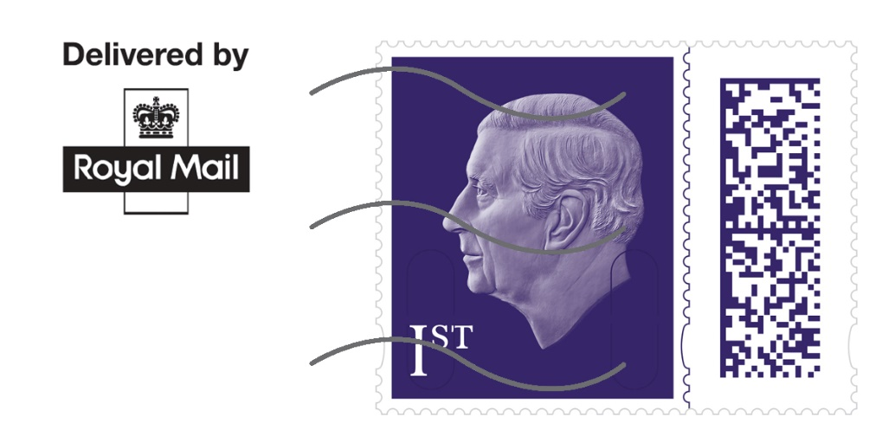
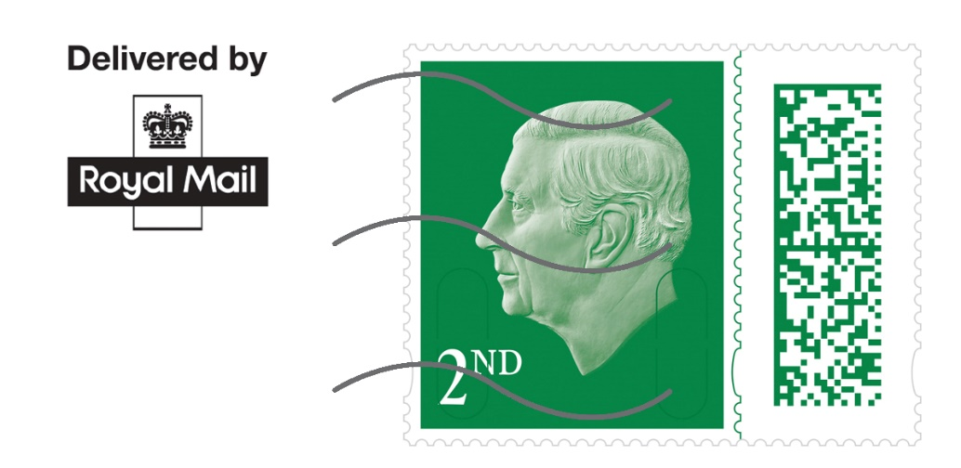
Update on the new King Charles Digital Stamp
In May this year we announced that we will be updating the choice of digital stamp options by replacing the Queen’s Head definitive stamp with the King’s Head definitive stamp.
Our test of the Kings Charles Digital Stamp have been unsuccessful. We continue to test the new designs to make sure that the stamps can be processed efficiently through our machines.
Therefore we have decided to delay the launch of the new King Charles Digital Stamps. As a reminder, you will have the option of using the Queen’s head definitive Digital Stamps up to the 31st July 2023. After that the Alice in Wonderland collectable Digital Stamp will be available ongoing.
We will continue to work on the King Charles Digital Stamps and will update you once the stamps have been finalised.

Slide 3
For more information please get in touch : retail.stampindicia <retail.stampindicia@royalmail.com>

